Slide 1
Chapter 2: Intro to Relational Model
Notes:
In Chapter 2, we will learn about the relational data model. While there have been other data models, such as the network model or the hierarchical model, the relational data model has been the primary data model for most commercial data processing applications for several decades. In this chapter, we will go over the fundamentals of the relational data model.

Slide 2

Example of a Relation (Table)
attributes
(or columns)
tuples
(or rows)
Instructor Relation
Notes:
A relational database consists of a collection of relations or tables. Every relation, which is also called a table, has a unique name. In this example, we have the instructor table. Each table consists of several attributes which are the columns in the table. In each table, we have several rows. Each row, which is also called a tuple, records information about a single instructor. Thus, at the very basic level, we have a table which consists of columns and rows.

Slide 3
Attribute Types
The set of allowed values for each attribute is called the domain of the attribute
Attribute values are required to be atomic;
that is, indivisible
  Not what the domain itself is, but rather how we use domain elements in the database
The special value null is a member of every domain. Indicated that the value is “unknown”
Notes:
Now we will look at the properties of attributes, which are also called columns of a table. For each attribute, there is a set of allowed values that is called the domain of the attribute. For example, the set of all possible salary values is the domain of the salary attribute.
The next important property of an attribute is that the values are required to be atomic or indivisible. That is, in simplest terms, a user cannot store more than a single value in a particular cell.
And lastly, the special keyword null is allowed in every domain. It is used to indicate that the value is unknown.

Slide 4
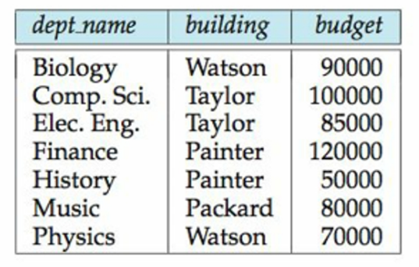

Database Schema
A database schema is a logical design of a database
A relation schema consists of a list of attributes and their corresponding domains.
Relation schema:
Department relation
Notes:
A database schema is a logical design of a database, whereas a relation schema consists of a list of attributes and their corresponding domains.
Here, in this example, we have the department relation. In order to write the relation schema, we first write the table name, and then attribute names inside a parenthesis.

Slide 5

Keys
Let K ⊆ R
K is a superkey of R if values for K are sufficient to identify a unique tuple of each possible relation r(R)
Two superkeys in this
Instructor relation:
{ID}
{ID, name}
Notes:
The next important concept to know in databases is that of keys. In a table, there has to be a way to specify how individual rows can be uniquely identified. A superkey is an attribute or a set of attributes in table that can uniquely identify a tuple.
In this example, the column ID can uniquely identify a tuple. That is, given a specific ID, let us say 22222, you can retrieve all the information in the table for that specific row, which in this case is for the instructor Einstein.
If you look at this specific data, you might say that the column name is also unique for each person, and hence should be a key. But you also need to use common sense while designing a database system. It is perfectly possible in the future, that there can be another instructor named Einstein who joins the university. Thus, ID is a superkey, while name is not a superkey.
Also, note that, the set {ID, name} can also uniquely identify a tuple. If I gave you the information 12121 and Wu, you can also uniquely identify a tuple and return all information in the tuple. Hence, {ID, name} is also a superkey.
In this slide, R is the set of all attributes in the relation, and K is the set of attributes that forms the superkey. Apart from uniquely identifying a tuple, note that, keys are also important in avoiding redundancy in tables.

Slide 6
Candidate Keys
Superkey K is a candidate key if K is minimal
If you have multiple candidate keys, any one of the candidate keys is selected to be the primary key.
Which of these superkeys
is a candidate key?
{ID}
{ID, name}
Notes:
A superkey K that is minimal is called a candidate key. In this example, the superkey ID, Name is not a candidate key because it is not minimal, that is, even after removing the attribute Name from the superkey, one can still uniquely identify any tuple with the remaining attributes {i.e. ID}.
Thus, in this example, ID is a candidate key because it is minimal. If you have more than 1 candidate key, then you choose any one of the keys to be a primary key.
In every table that you create, you have to define a primary key. We will look at more examples in the next chapter that will further help your understanding of keys and primary keys.

Slide 7
Superkeys vs. Candidate keys
All candidate keys are superkeys but not all superkeys are candidate keys.
Superkeys
E.g., {ID, name} is a superkey
but not a candidate key
{ID} is a candidate key and
also a superkey.
Candidate
keys
Notes:
Note that, all candidate keys are superkeys but not all superkeys are candidate keys. For example, the key ID, name is a superkey because it can uniquely identify a tuple, but it is not a candidate key because it is not minimal. Whereas, ID is a candidate key and also a superkey.
So to recap, keys help in uniquely identifying a single tuple, every candidate key is a superkey, but not every super key is a candidate key, and any candidate key is designated to be a primary key.

Slide 8
Foreign Keys
Foreign key constraint: Value in one relation must appear in another
  Referencing relation
  Referenced relation
Department relation
Instructor relation
Notes:
Now we will look at foreign key constraints, which help in defining a connection between 2 tables. A foreign key is basically a column or a set of columns in a table that refers to a primary key in another table.
Let us look at this example where we have 2 tables: the instructor table and the department table. We know that the column ID is the primary key of the instructor table. For the department table, the department name is the primary key of the table, because no two departments in a university can have the same name.
Here, the attribute dept_name in the Instructor table is defined as a foreign key – where the instructor table is the referencing relation and the department table is the referenced relation. What the foreign key constraint ensures is that there can be no value in the dept_name column of the instructor table that does not exist in the department table. This is an example of a referential integrity constraint, which we will look at further in Chapter 4.
Think about it: every department in the university must exist in the department table. Also, an instructor should belong to a department that actually exists in the university. Thus, the foreign key constraint makes sure that no wrong department name is accidentally added to the Instructor relation.

Slide 9
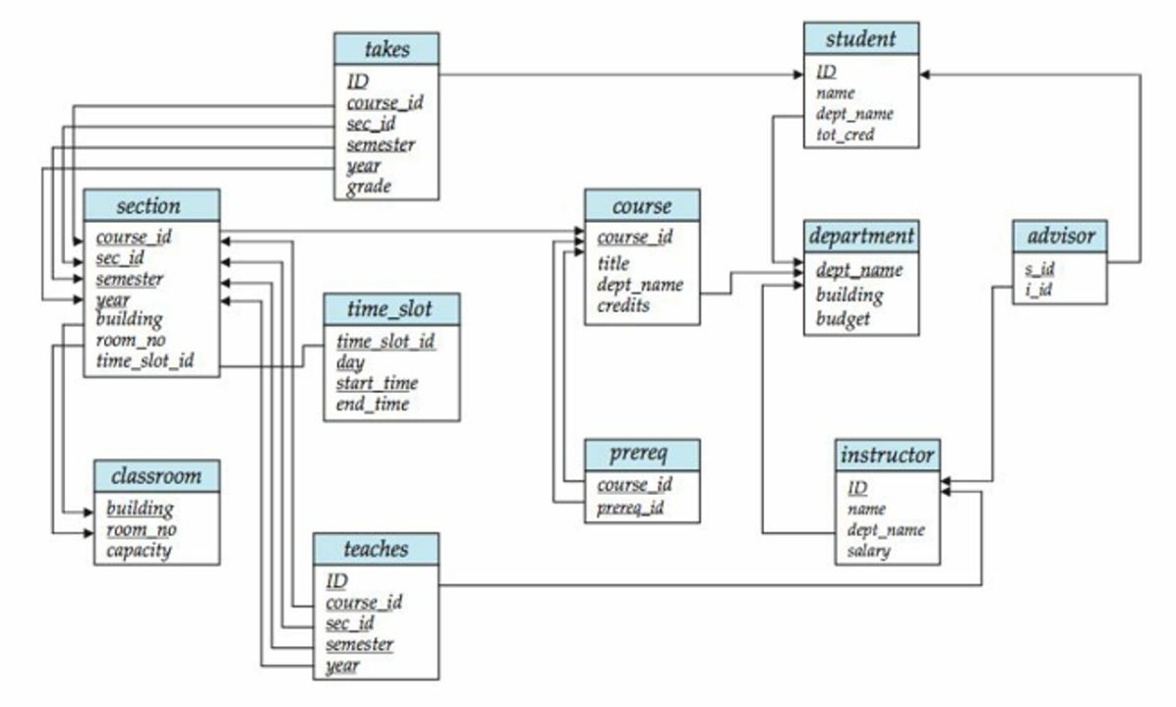
Schema Diagrams
A database schema, along with primary key and foreign key dependencies, can be depicted by schema diagrams.
Notes:
Schema diagrams help depict the different tables of a database along with the relationships between the tables, and also primary key and foreign key dependencies. This figure is an example of a schema diagram representing the university database example. In Chapter 7, we will be looking at a different diagrammatic representation called the ER diagram.

Slide 10
Relational Query Languages
Procedural vs non-procedural (also called declarative)
“Pure” languages:
  Relational algebra
  Tuple relational calculus
  Domain relational calculus
The above 3 pure languages are equivalent in computing power
We will concentrate in this chapter on relational algebra
  consists of 7 basic relational operations
Notes:
Once you have data in a database, there has to be a mechanism to query the data. A query language is a language in which a user requests information from the database. In general, query languages are simpler or on a level higher than that of a standard programming language, like Java.
There are two types of query languages: In a procedural language, the user instructs the system to perform a sequence of operations on the database to compute the desired result.
On the other hand, in a non-procedural language, the user describes the desired information without giving a specific procedure for obtaining that information. The widely used query language SQL is a non-procedural language – because we only tell the database what kind of information we are looking for. As long as the syntax of the query is correct, the database figures out how to retrieve the information that we are looking for.
Pure query languages mainly are created to illustrate the fundamental techniques for extracting data from the database. Pure languages lack the sugar coating of commercial languages. Of these 3 pure query languages, Relational algebra is procedural whereas tuple and domain relational calculus are non-procedural languages. We will learn more about Relational Algebra in Chapter 6.
In the next few slides, we will go over a few basic relational operations that we will be using while learning SQL in the next few chapters.

Slide 11
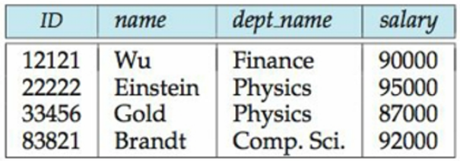
Select Operation – selection of rows (tuples)
Instructor relation
Find instructors whose salary
is greater than $85000
Notes:
The most frequent relational operation is the selection of specific tuples, or rows, from a single relation that satisfies some particular predicate. For example, let us say we want to find instructors whose salary is greater than $85000. Here, predicate is greater than $85000. The result of this operation is a subset of the original relation, which would be these 4 rows.

Slide 12
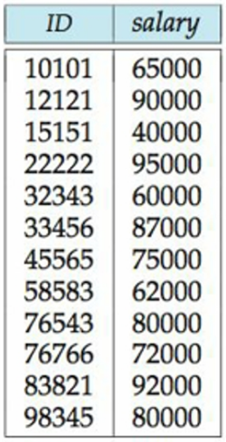
Project Operation – selection of columns (Attributes)
If we only want a list of instructor IDs and salaries:
Instructor relation
Notes:
Another frequent operation is to select certain attributes, or columns, from a relation. The result is a new relation having only those selected attributes. For example, suppose we want a list of instructor IDs and salaries without listing the name and department name from the instructor relation. Then the result would be this relation that only has 2 columns, ID and salary.

Slide 13
Natural Join Operation
Natural Join operation returns tuples whose values are the same on all attributes names that are common to both relations
We want to display information of the instructor and all information of the department that they work in
Department relation
Instructor relation
Notes:
The join operation allows the combination of two relations by merging pairs of tuples, one from each relation, into a single tuple. In the next few chapters, we will look at different types of joins. In this slide, we will look at the natural join operation, that only returns tuples whose values are the same on all attribute names that are common to both relations.
In our example, let us say we want to display information of the instructor and all the information of the department that the instructor works in.
In order to get this information, we will have to do a natural join between the instructor relation and the department relation. Here, the common attribute is the department name.

Slide 14
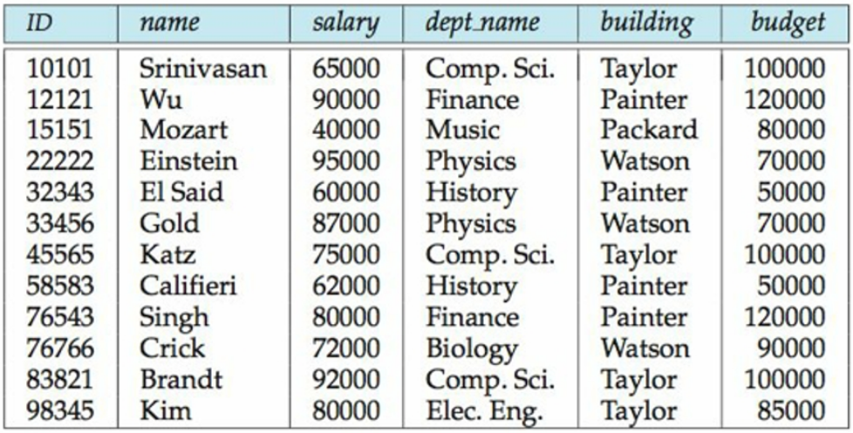
Natural Join Operation
Natural Join operation returns tuples whose values are the same on all attributes names that are common to both relations
Let us say we want to display information of the instructor and all information of the department that they work in
The result would be the following single table:
Notes:
The result would be this following single table. Where we add 2 more columns that stores information regarding the department in each row.

Slide 15
Cartesian Product Operation
Cartesian Product Operation combines tuples from two relations, but unlike the join operation, its result contains all pairs of tuples from the two relations.
  Regardless of whether their attribute values match.
Department relation
Instructor relation
Notes:
The Cartesian Product Operation combines tuples from two relations, but unlike the join operation, its result contains all pairs of tuples from the two relations, regardless of whether their attribute values match.
In this example, for every row in the instructor relation, we will combine information with every row in the department relation. We have 12 rows in the instructor relation and 7 rows in the department relation. The result of a cartesian product between these two relations will include 12 times 7, that is 84 rows.

Slide 16

joining two relations -- Cartesian-product
Relations r, s:
r x s:
Notes:
In the next few slides, there are examples for you to solve on your own. I hope that you spend a few minutes actually solving them, even if they look quite trivial. The symbols used in the next few slides are the relational algebra operations that we will learn in Chapter 6. For now, I want you to focus on understanding what output you will get from using these operators.
I am now going to skip to the last slide of this chapter, slide number 32. Please pause this video, and solve and understand the practice examples before you start the next chapter.

Slide 17
joining two relations -- Cartesian-product
Relations r, s:
r x s:

Slide 18
joining two relations -- Cartesian-product
Relations r, s:
r x s:

Slide 19
Cartesian-product – naming issue
B
Relations r, s:
r.B
s.B
r x s:

Slide 20

Union of two relations
Relations r, s:
r ∪ s:

Slide 21
Union of two relations
Relations r, s:
r ∪ s:

Slide 22

Set difference of two relations
Relations r, s:
r – s:

Slide 23
Set difference of two relations
Relations r, s:
r – s:

Slide 24

Set intersection of two relations
Relation r, s:
r ∩ s
Note: r ∩ s = r – (r – s)

Slide 25
Set intersection of two relations
Relation r, s:
r ∩ s

Slide 26

Composition of Operations
Can build expressions using multiple operations
Example: σ_{A=C} (r x s)
r x s
σ_{A=C} (r x s)

Slide 27
Composition of Operations
Can build expressions using multiple operations
Example: σ_{A=C} (r x s)
r x s
σ_{A=C} (r x s)

Slide 28

Natural Join Example
Relations r, s:
Natural Join
  r s
∏ _{A, r.B, C, r.D, E} (σ _{r.B = s.B ˄ r.D = s.D} (r x s)))

Slide 29
Natural Join Example
Relations r, s:
Natural Join
  r s
∏ _{A, r.B, C, r.D, E} (σ _{r.B = s.B ˄ r.D = s.D} (r x s)))
Notes:
5 total results

Slide 30
Natural Join Example
Relations r, s:
Natural Join
  r s
∏ _{A, r.B, C, r.D, E} (σ _{r.B = s.B ˄ r.D = s.D} (r x s)))

Slide 31
Summary of Relational Algebra Operators
Symbol (Name) Example of Use
σ
(Selection) ^{σ} salary > = 85000 ^{(instructor)}
Return rows of the input relation that satisfy the predicate.
Π
(Projection) ^{Π} ID, salary ^{(instructor)}
Output specified attributes from all rows of the input relation. Remove duplicate tuples from the output.
x
(Cartesian Product) instructor x department
Output pairs of rows from the two input relations that have the same value on all attributes that have the same name.
∪
(Union) ^{Π} name ^{(instructor) ∪ Π} name ^{(student)}
Output the union of tuples from the two input relations.
-
(Set Difference) ^{Π} name ^{(instructor)} ^{-- Π} name ^{(student)}
Output the set difference of tuples from the two input relations.
⋈
(Natural Join) instructor ⋈ department
Output pairs of rows from the two input relations that have the same value on all attributes that have the same name.

Slide 32
End of Chapter 2
Notes:
To recap, in this chapter, we looked at the fundamental concepts of the most widely used data model, called the relational model. The most important concepts to understand carefully from this slide are the concept of keys and the different relational operations.
In the next chapter, we will start learning SQL. Please make sure that you have understood how the relational operators work before you begin the next chapter.
Let me know if you have any questions in the discussion board. Chapter 2 done.

